Slide 1
The 2 Phases of Retirement
Peggy L. Sanders, Attorney at Law
Sanders Law Group
152 Third Avenue S., Suite 101
Edmonds, WA 98020
peggy@sanderslawgroupNW.com
(425) 640-8686

Slide 2
Phase 1 – Off to the races

Slide 3
Most of us like to think that we’ll live to our mid-80s, then we croak.

Slide 4
But worries start to creep in

Slide 5
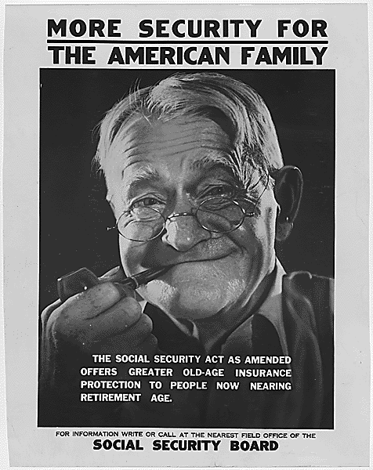
Retirement Phase 2
When Social Security began, the average American could expect to live only 62 years, and there were 42 workers paying for each “aged” recipient.
Today life expectancy is approaching 79 (and steadily rising) and due to decades of declining fertility, there are fewer than three workers to pay for each recipient.

Slide 6
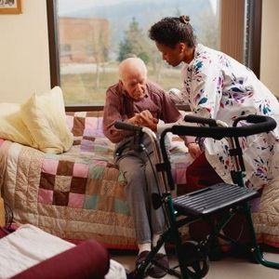
We are living longer but not necessarily healthier.

Slide 7
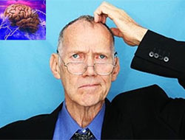
Am I starting to lose my marbles? (That’s a legal term.)

Slide 8
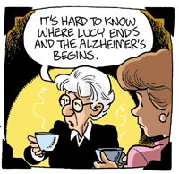
Our institutions weren’t designed to deal with Alzheimer’s and other forms of dementia

Slide 9
This where an Elder Law Attorney comes in.
Surveys show the three greatest concerns for seniors:
Preserve Assets
Live at Home for as long as possible
Not be a burden to loved ones

Slide 10
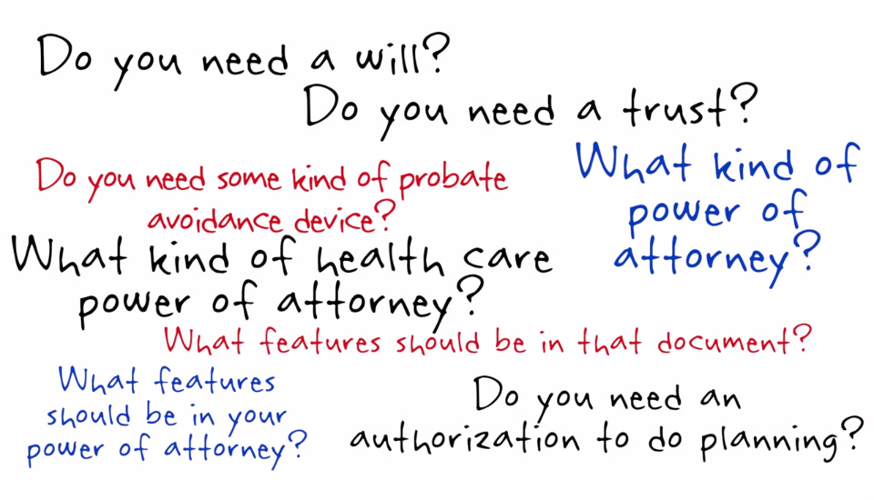
Attorneys who work in the field of Elder Law bring more to their practice than an expertise in the appropriate area of law. They also have knowledge of the senior population and their unique needs as well as the myths related to competence and aging. They are aware of the physical and mental difficulties that often accompany the aging process. Because of their broad knowledge base they are able to more thoroughly address the legal needs of their clients.
For example, when planning an estate, an elder law attorney would take into consideration the health of the person or couple, the potential for nursing home care and the wishes and concerns of the person or couple if that event were to occur. If need arises, the elder law attorney will associate other legal experts.
Elder law covers all aspects of planning, counseling, education, and advocating for clients. Elder law attorneys are a resource to their clients because they understand their clients’ needs may extend beyond basic legal services and stay informed about and connected to the local networks of professionals who serve the elder population.

Slide 11
What we’ll talk about today.
Powers of Attorney
Guardianship
Medicaid
VA Benefits

Slide 12
There is no such thing as a Transfer on Stroke Account
.

Slide 13
SOME BASICS
Powers of Attorney are critical
Needed before they’re needed
Wills should be updated if clients are anticipating the need to use Medicaid benefits immediately or down the road.

Slide 14
And how do we pay?
Four Sources
Private Funds
VA Pension Benefits
Medical Benefits
Family Care Givers

Slide 15
VA Benefits
VA benefits are available to many more people than you might think.
“War time” does not mean a client had to be on the battlefield.
Service Connected vs. Non-service Connected.
Aid and Attendance
Much higher resource limits
How to coordinate with Medicaid
Unfortunately, it’s taking a very long time for the VA to process applications for disability benefits.

Slide 16
Then there’s Medicaid – First the Basics
Some terms:
Medicaid Spouse
Community Spouse
Community Spouse Resource Allowance
Available Resources
By the Book (sort of):
Medicaid Spouse – $2,000 in assets, income of less than $7,039 for the COPES program (other limits for other types of Medicaid)
Community Spouse – $55,547 up to $123,600 in assets, no limit on income
Exempt Resources – house, car, personal belongings

Slide 17
Now, how an Elder Law Attorney can help
We can often take advantage of Medicaid benefits even if there are some assets.
Gifts and Penalty period
Unlimited transfers to spouses
Penalty for transfers to other than spouses
House – to sell or not to sell
Trusts?
Spend down
Divorce? Not necessary.

Slide 18
Adult Protection

Slide 19
Adult Protection
Vulnerable Adults
The law also provides for a Vulnerable Adult Protection Order (VAPO) to protect vulnerable adults for risks of harm or financial exploitation.
Reporting cases of abuse
Rich Uncle Harry’s new wife…

Slide 20
GUARDIANSHIP

Slide 21
Guardianship
A court must determine that the person has “a significant risk of personal harm based upon a demonstrated inability to adequately provide for nutrition, health, housing or physical safety.”
Getting a guardianship is a formal legal action and can be very expensive.
My message is that having a Power of Attorney can avoid the expensive and time-consuming process of getting a guardian.

Slide 22
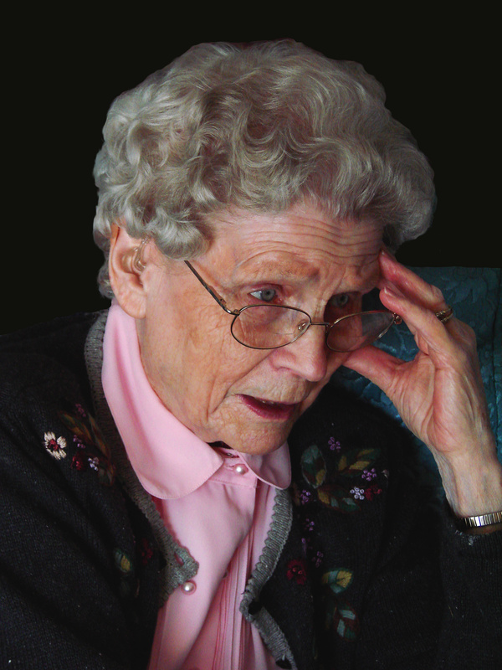
Questions?

Slide 23
Peggy L. Sanders, Attorney at Law Sanders Law Group 152 Third Avenue S., Suite 101 Edmonds, WA 98020 peggy@sanderslawgroupnw.com (425) 640-8686

